Slide 1
HR graphics
FINALL
Everything included in the file is from the doctor's LEC

Slide 2
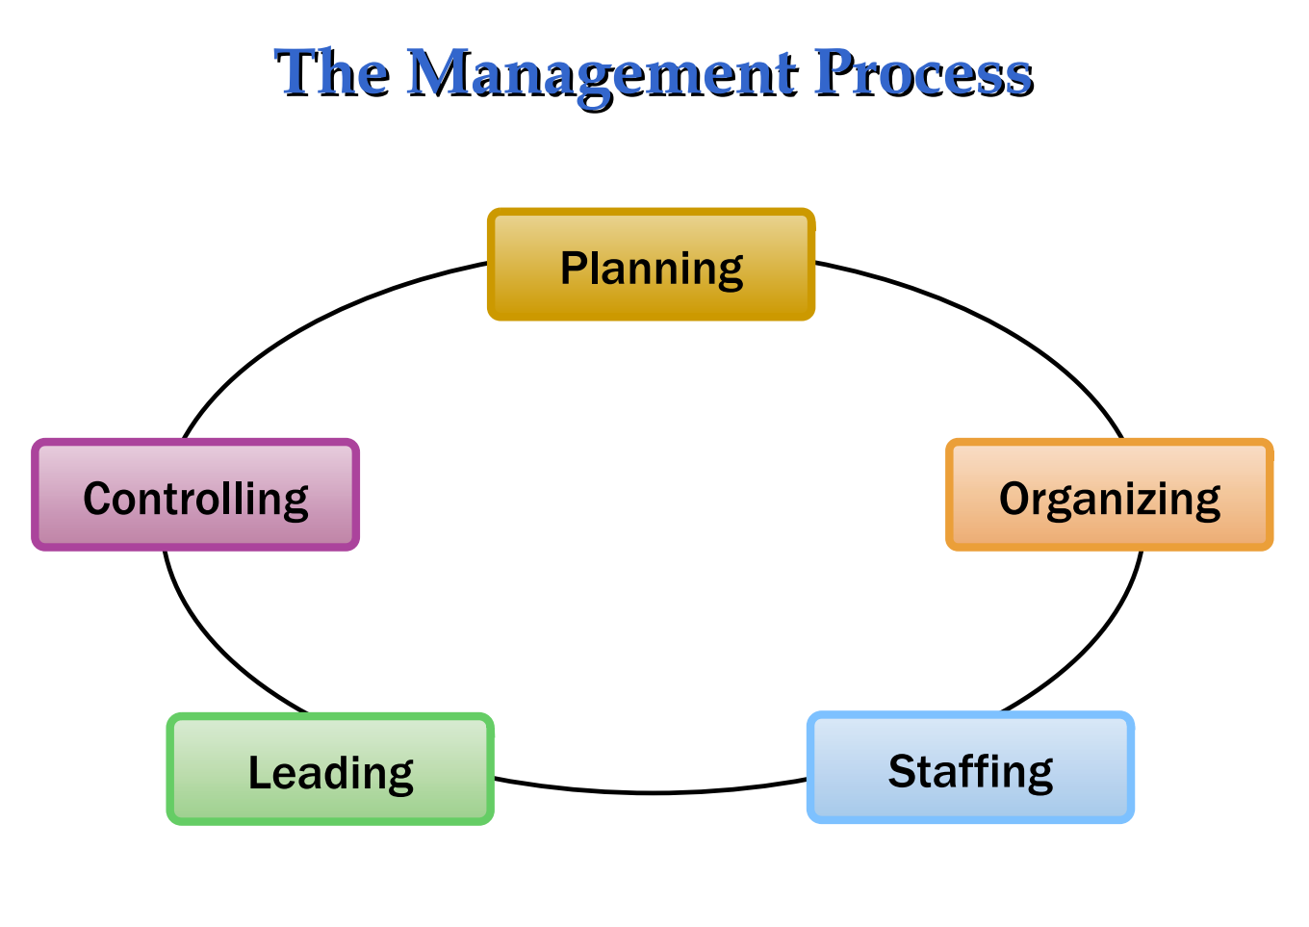
LEC 1

Slide 3
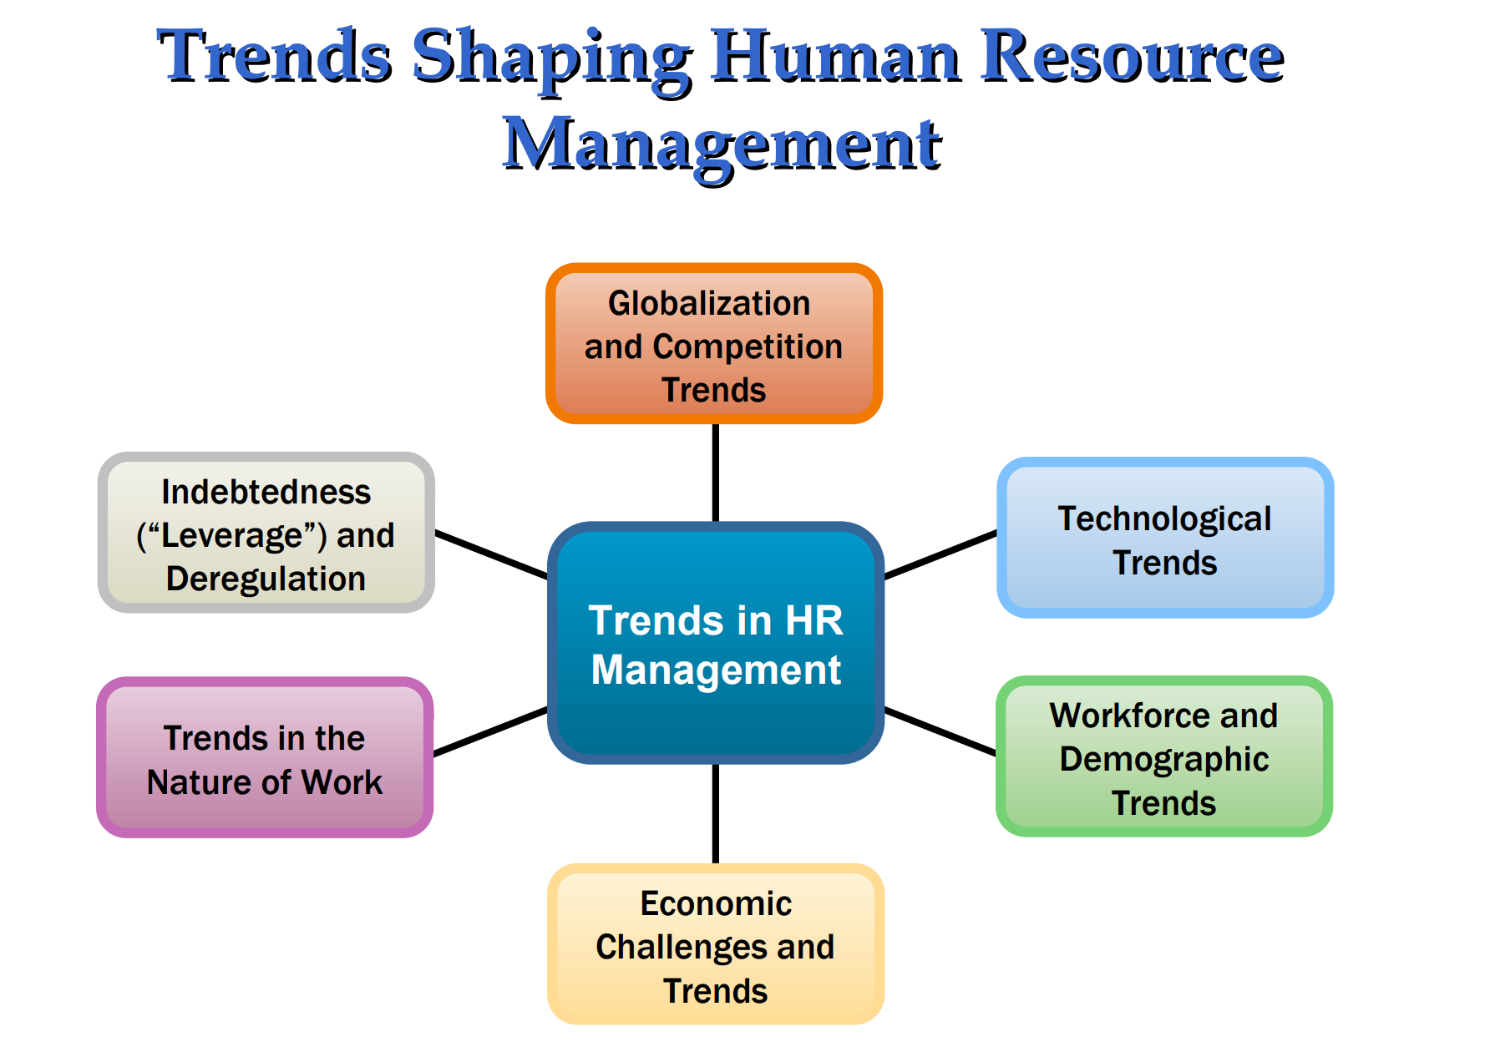
LEC 2

Slide 4
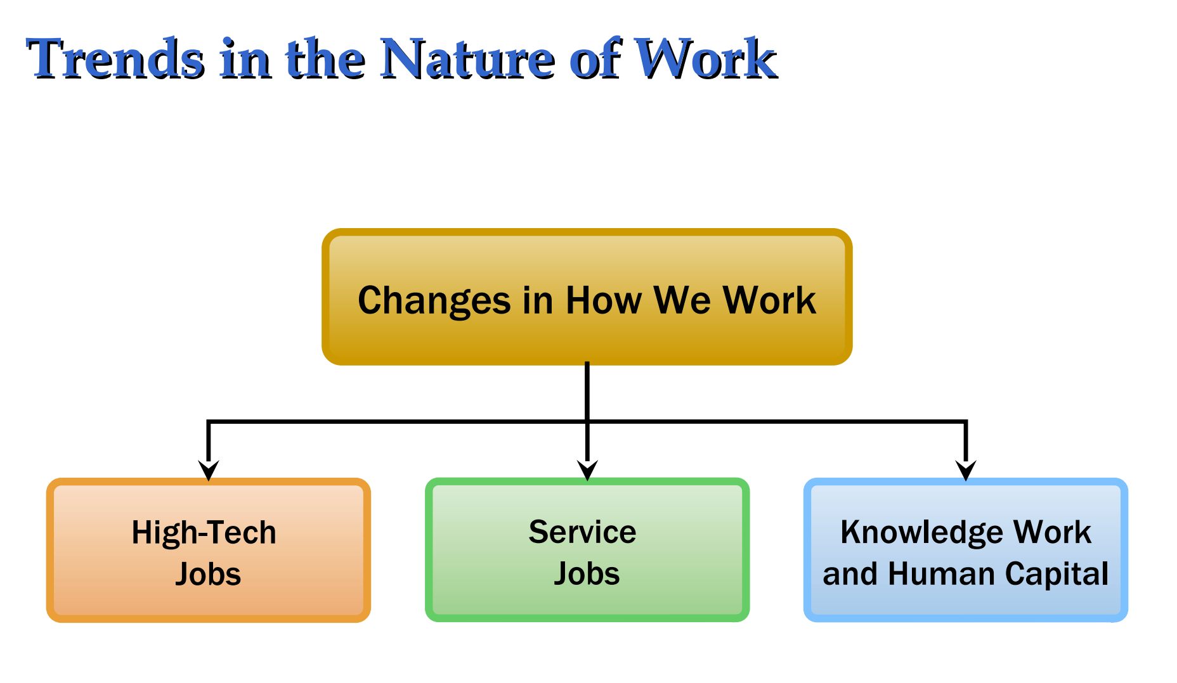
LEC 2

Slide 5
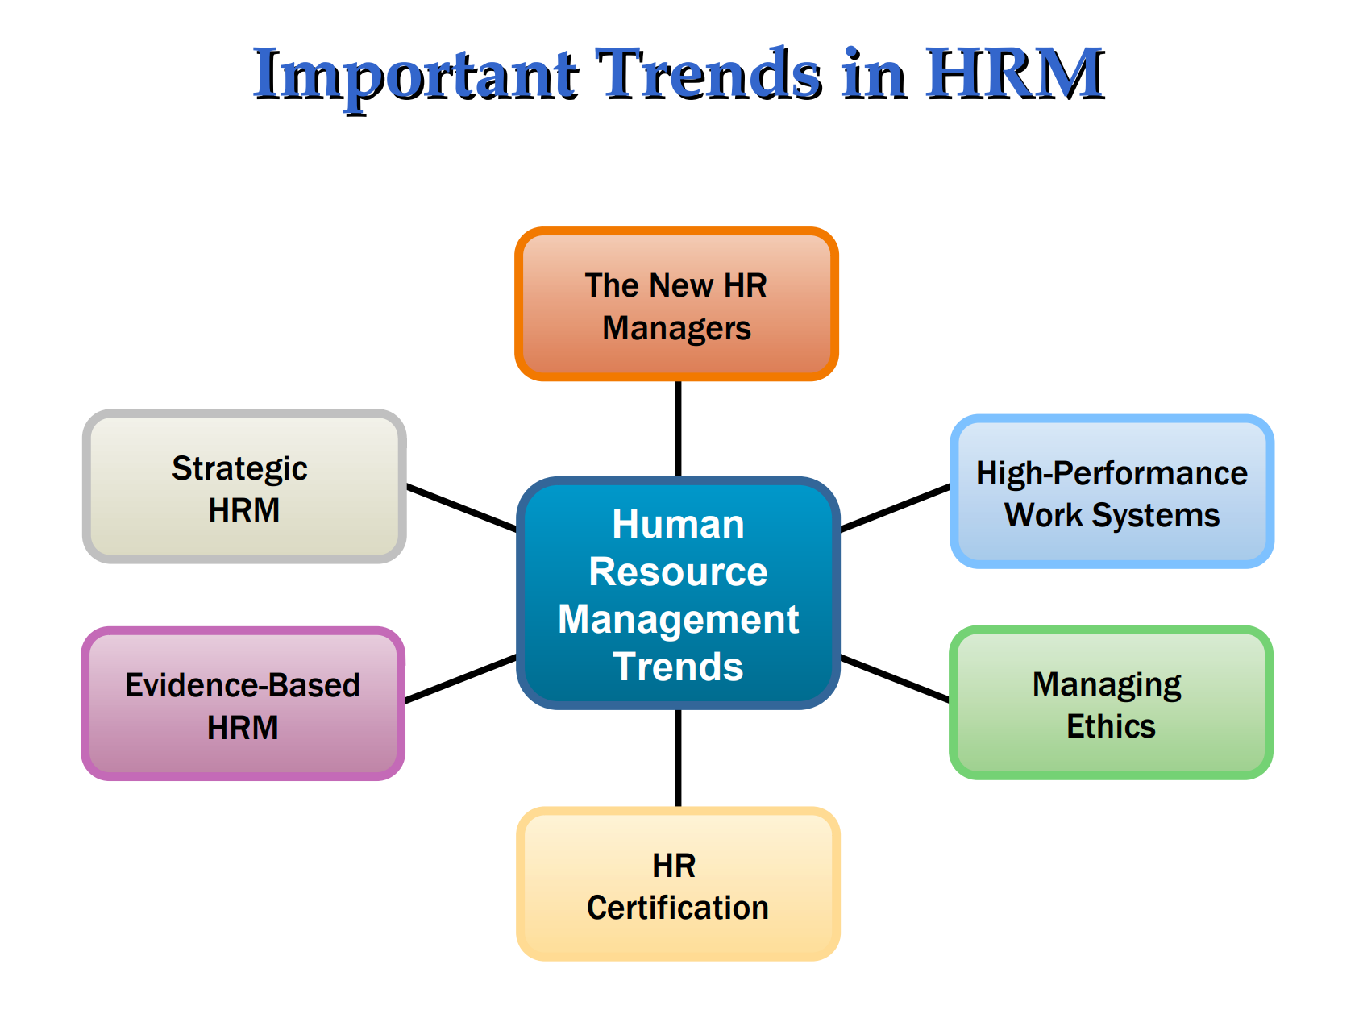
LEC 2

Slide 6
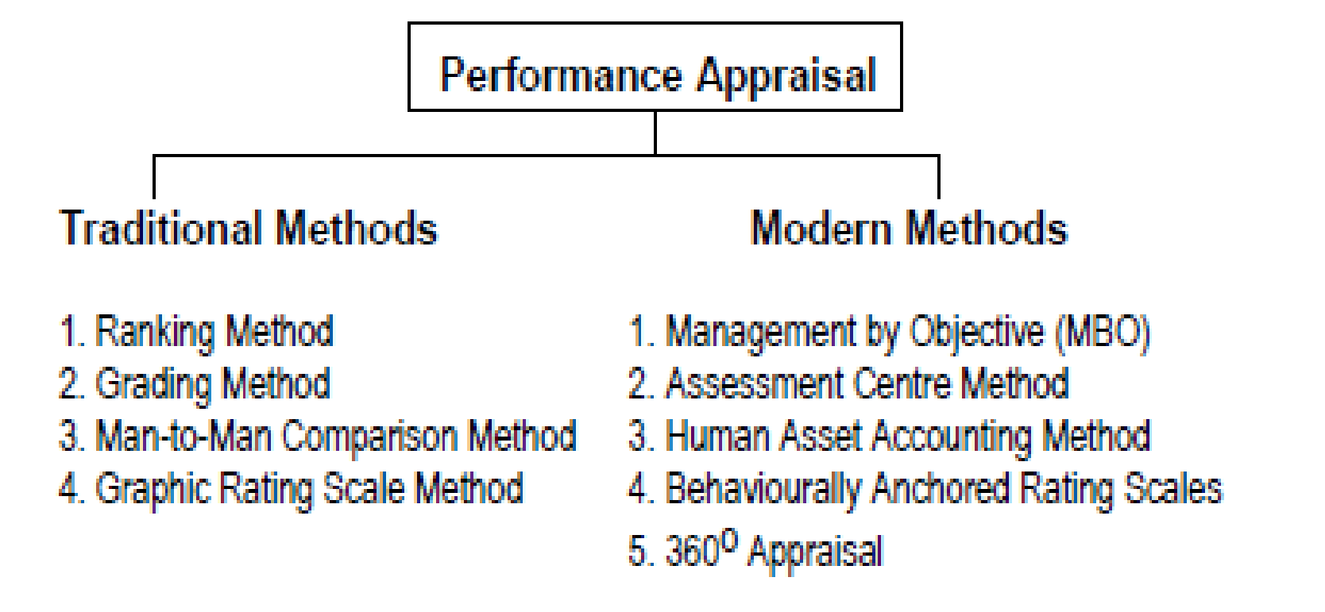
LEC 4

Slide 7
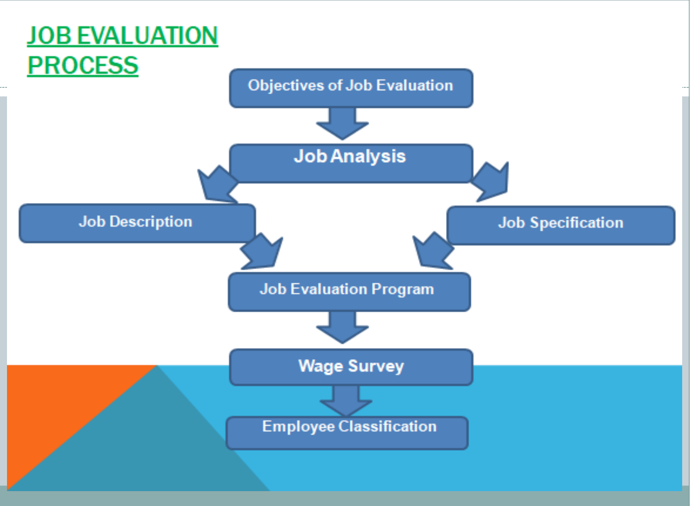
LEC 5

Slide 8
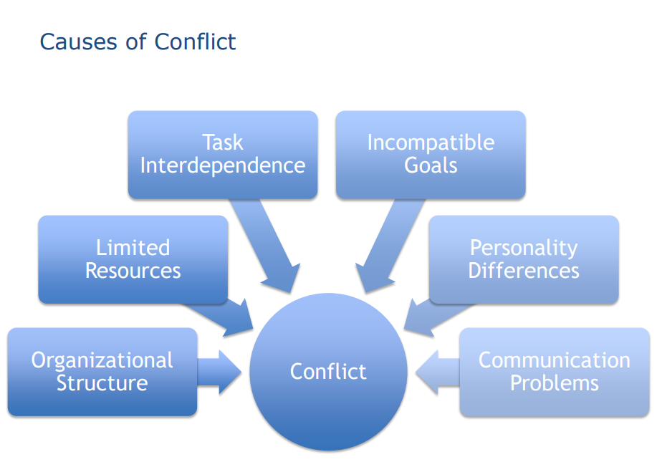
LEC 9

Slide 9
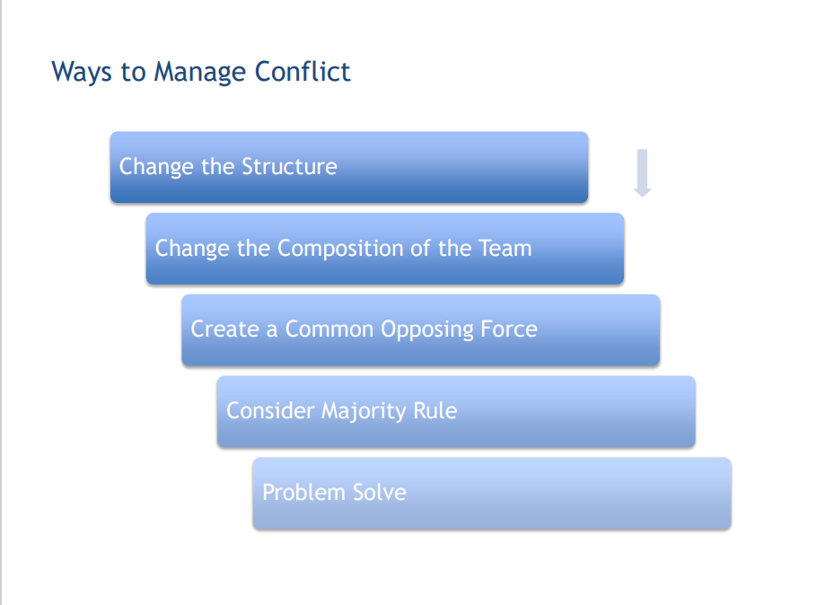
LEC 9

Slide 10
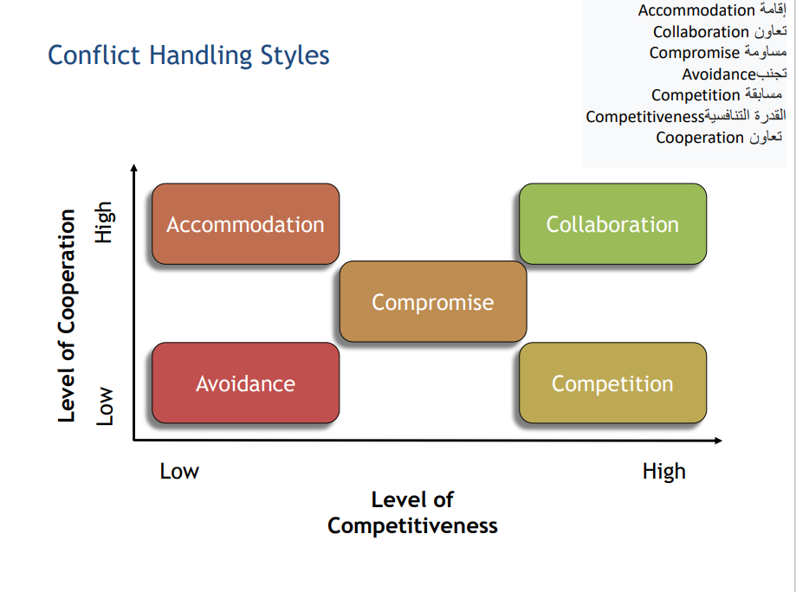
LEC 9

Slide 11
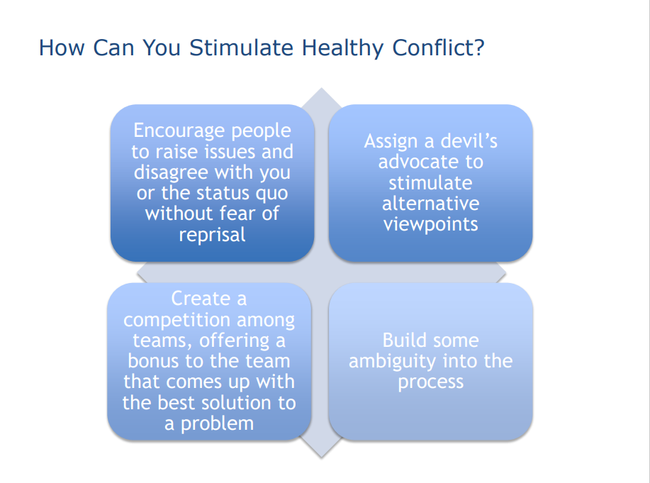
LEC 9

Slide 12
LEC 9

Slide 13
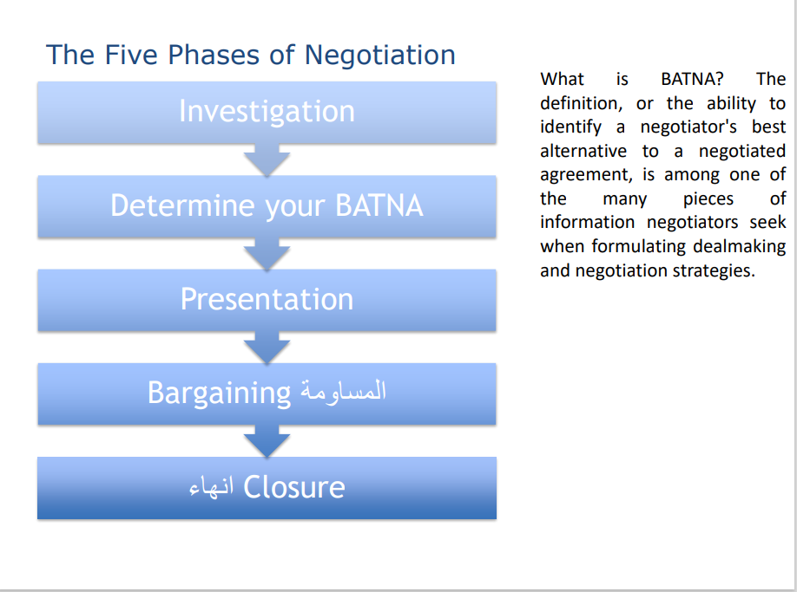
LEC 9

Slide 14

LEC 9

Slide 15
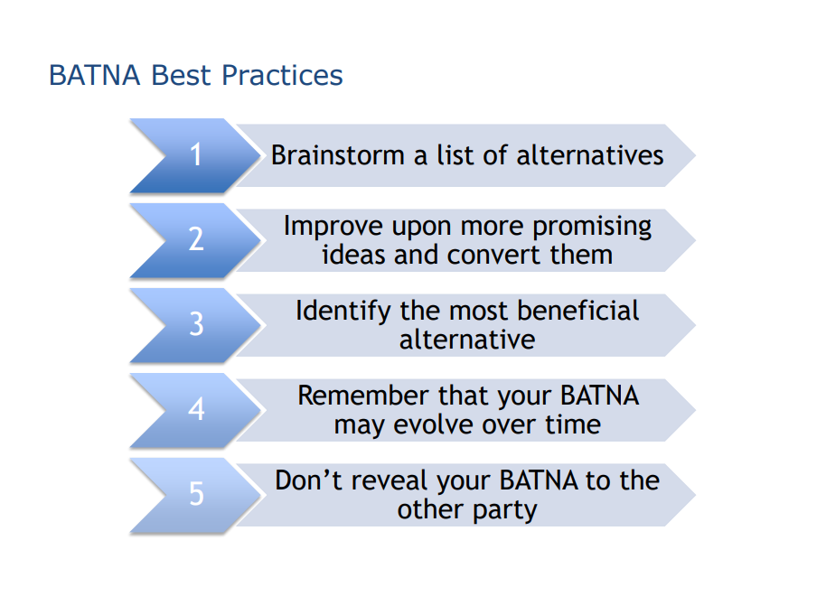
LEC 9

Slide 16
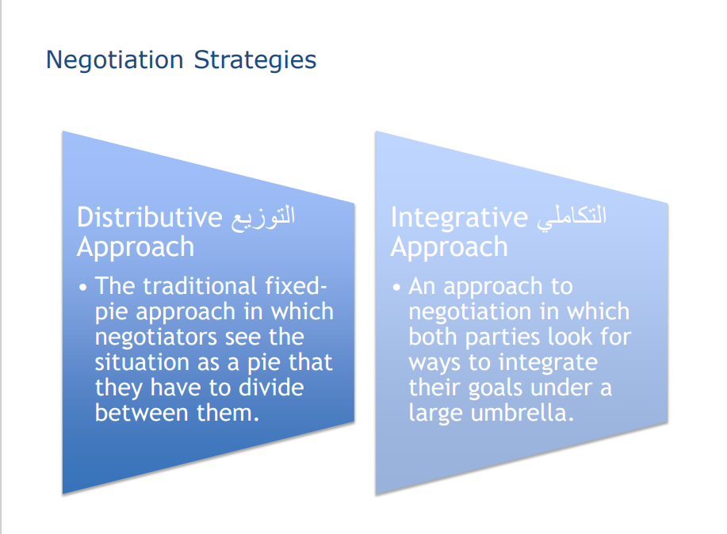
LEC 9

Slide 17
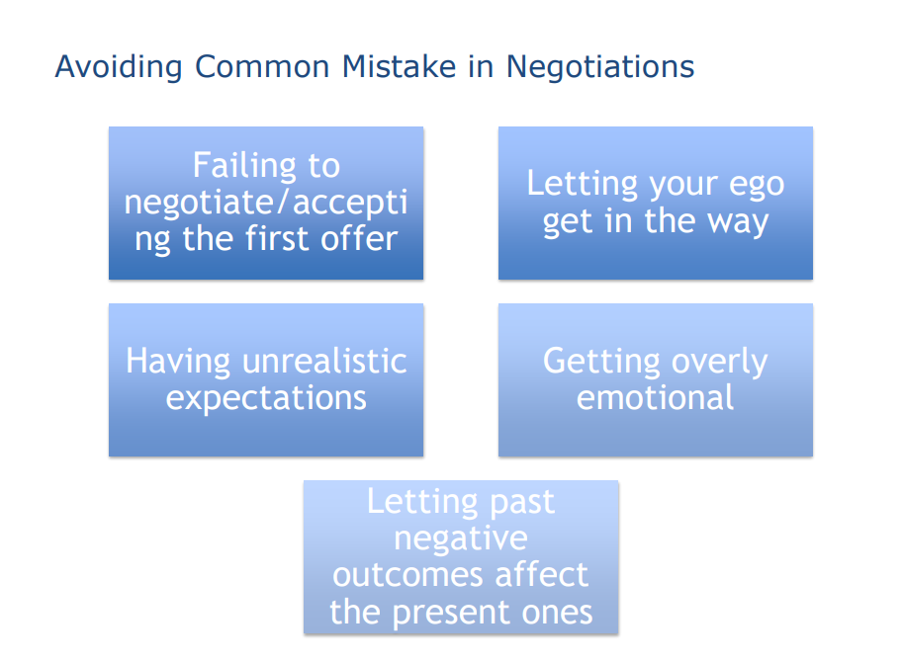
LEC 9

Slide 18
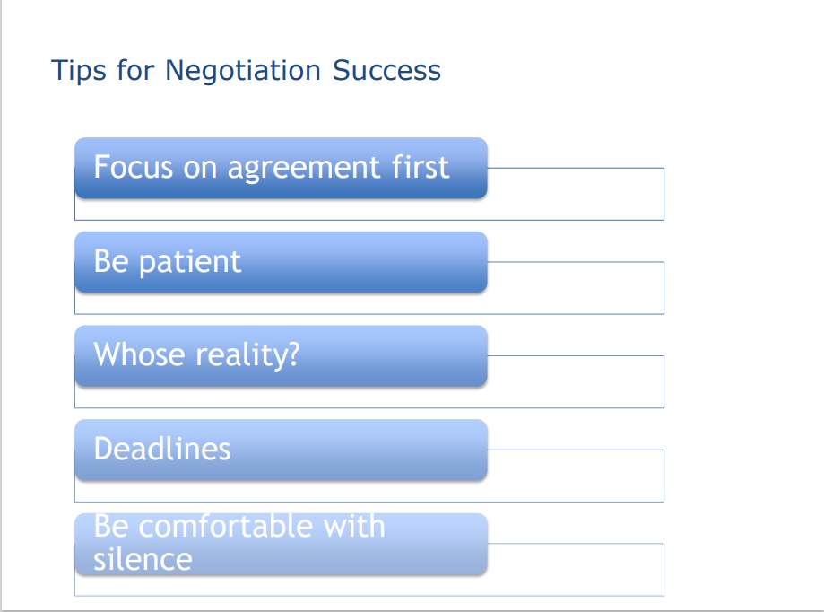
LEC 9

Slide 19
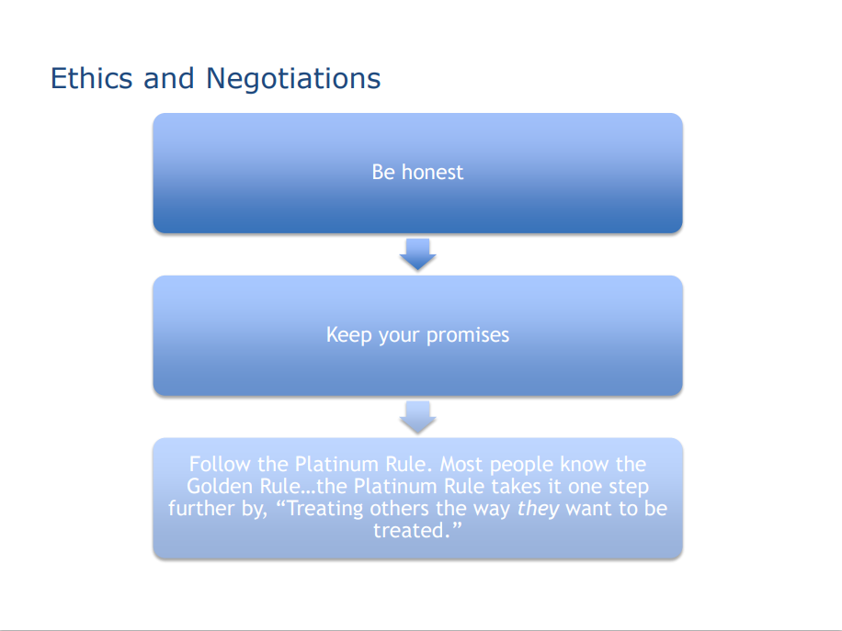
LEC 9

Slide 20
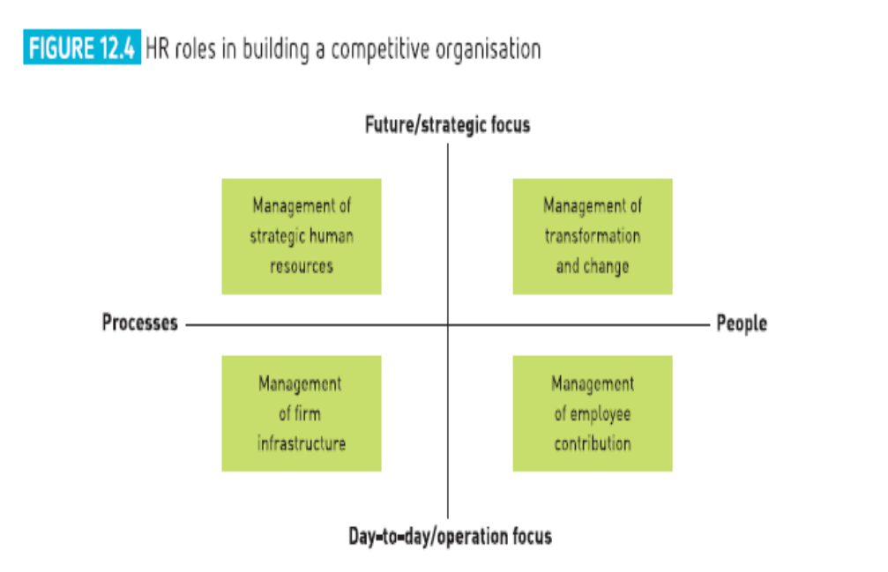
LEC 10

